Slide 1
Data-Driven Behavioral Analytics: Observations, Representations and Models
Meng Jiang (UIUC)
Peng Cui (Tsinghua)
Jiawei Han (UIUC)
http://www.meng-jiang.com/tutorial-cikm16.html
Tutorial in CIKM 2016, October 24, Indianapolis, IN
Notes:
[University]

Slide 2
I. Mining behavior networks with social and spatiotemporal contexts
I.1. Behavior prediction and recommendation

Slide 3
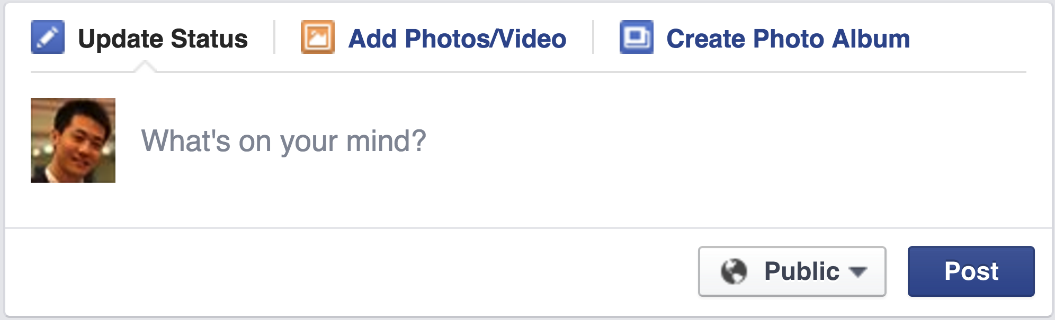
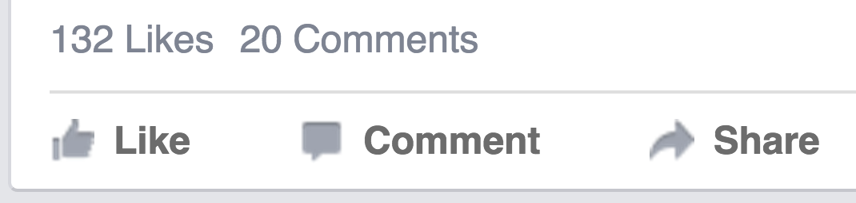
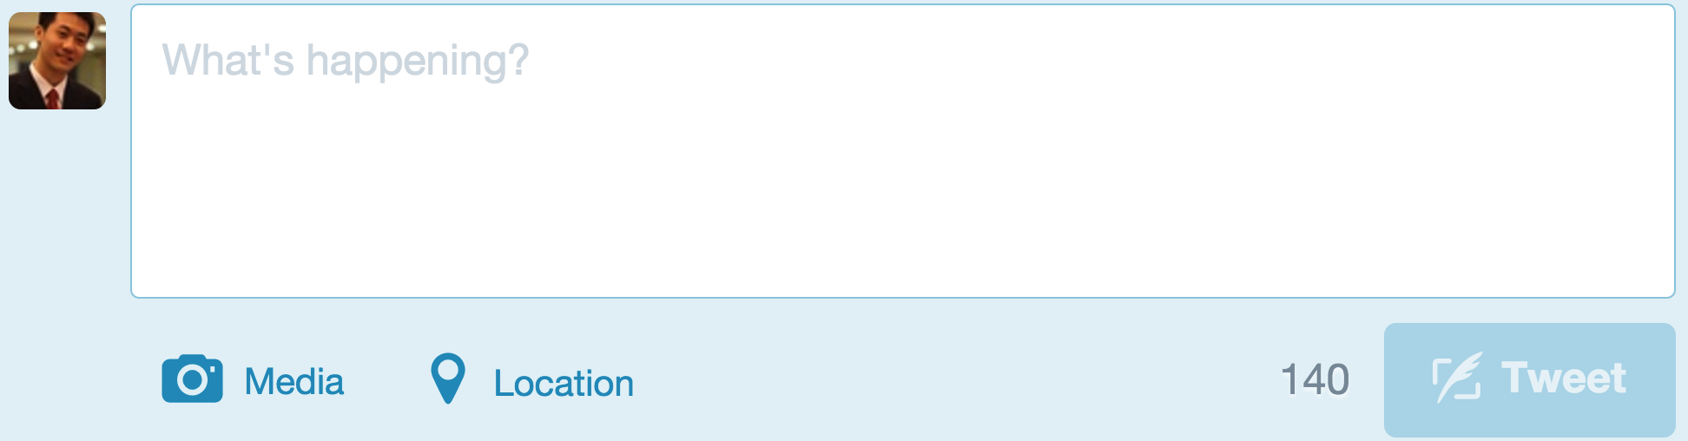


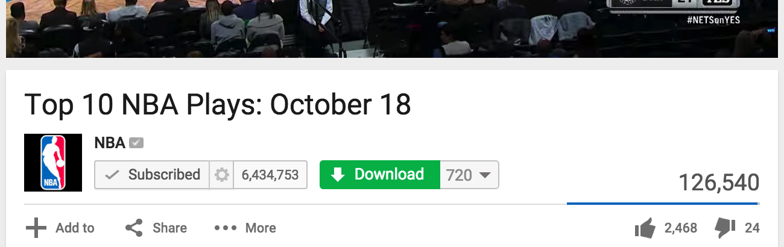
Behavior in Social Networks
Facebook: Post, Like, Comment, Share
Twitter: Post, Reply, Retweet, Favorite
YouTube: Upload, Subscribe, Download, Share, Comment

Slide 4

Behavior in Social Networks
Like
Reply
Share
Favorite
Retweet
Comment
Subscribe
Download
Add to
Send
Pin it
Visit
……

Slide 5




Social Recommender Systems
YouTube
Twitter
Pinterest
Facebook

Slide 6
Social Recommender Systems
April 20, 2011: Tencent Weibo visited Tsinghua University
Low conversion rate (< 6%): #retweets per feed request
Can we build a social recommender system?
Given
Predict which tweet/item a user will retweet.
Content similarity
(topic level) [Blei et al.]
User-item behavior network
User-user social network
i
sender
u
i
0.1
send
u
u
i
u
i
0.9
0.7
receive
u
i
receiver
i
u
i
u

Slide 7
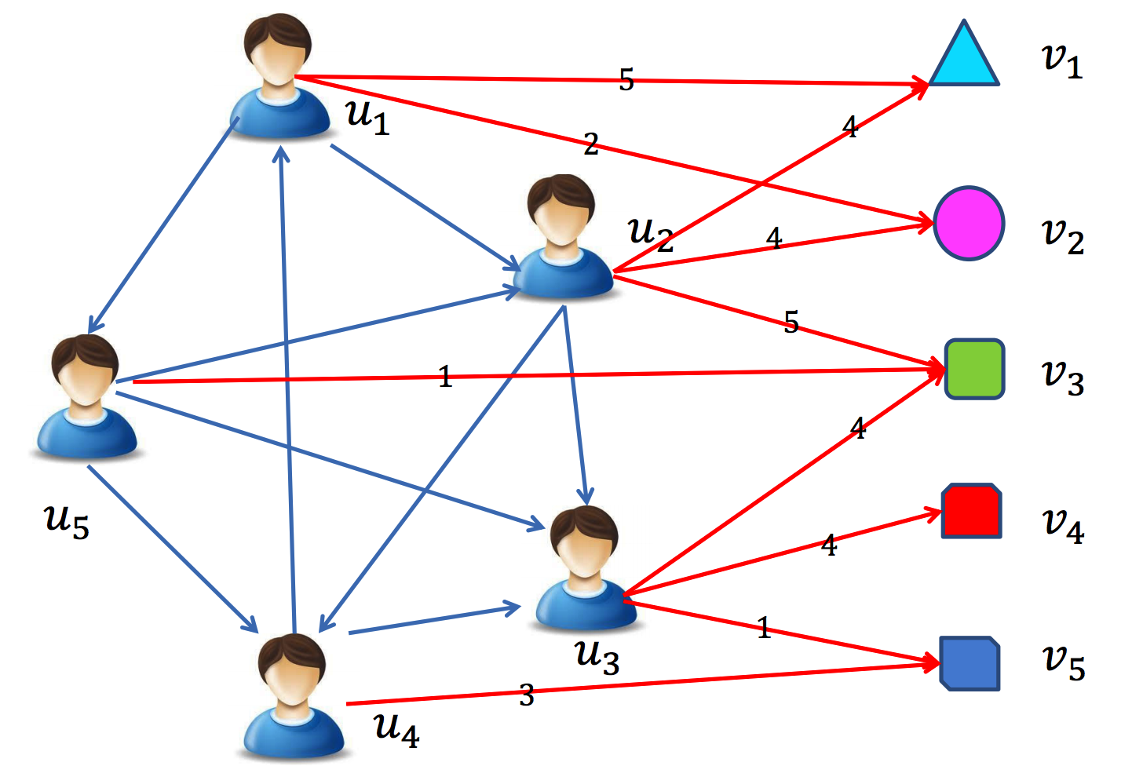
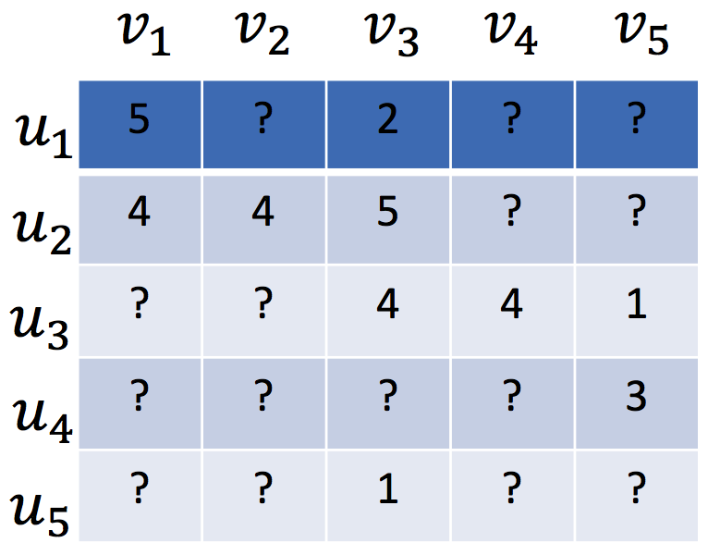
Traditional Recommender Systems
Assumed that users are independent and identically distributed (user-movie, user-book, etc.)
Notes:
Sparse user-item matrix.

Slide 8
Traditional Recommender Systems
Content-based recommender (e.g., TF-IDF)
For textual information (e.g., news, documents)
Limitation: limited content analysis, over-specialization
Collaborative filtering based recommender
Memory-based CF (e.g., PCC, similarity)
Model-based CF (e.g., factorization based)
Limitation: data sparsity, cold-start problem
Hybrid recommender system
Tang et al. Social Recommendation: A Review. Social Network Analysis and Mining, 2013. Springer.
Notes:
Second, CF. What is cold-start?

Slide 9
Matrix Factorization (MF) based CF
Low-rank MF on the user-item rating matrix R
User preference vector U
Item characteristic vector V
R
U
V^{T}
Koren. Factorizatoin Meets the Neighborhood: A Multifaceted Collaborative Filtering Model. KDD, 2008.
Notes:
Dr. Yehuda Koren. Matrix factorization. Latent factors.

Slide 10
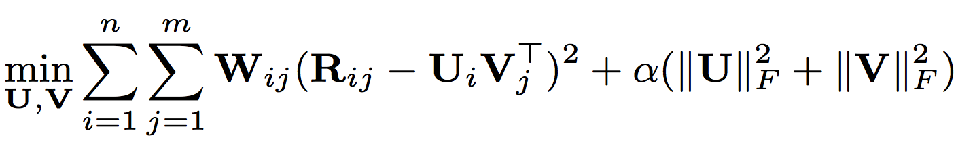
Matrix Factorization (MF) based CF
Low-rank MF on the user-item rating matrix R
User preference vector U
Item characteristic vector V
Observed weight matrix W
avoid over-fitting,
controlled by the parameter
Notes:
Observed indicators. Regularization to avoid over-fitting.

Slide 11
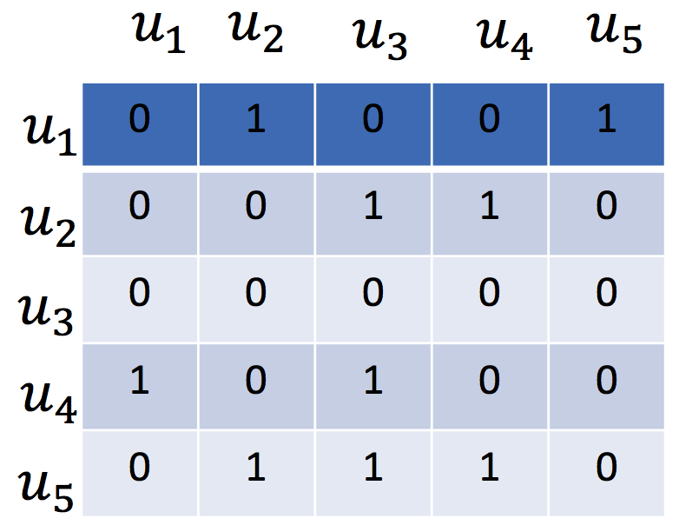
Social Recommendation
Social relations
Notes:
One more matrix input.

Slide 12
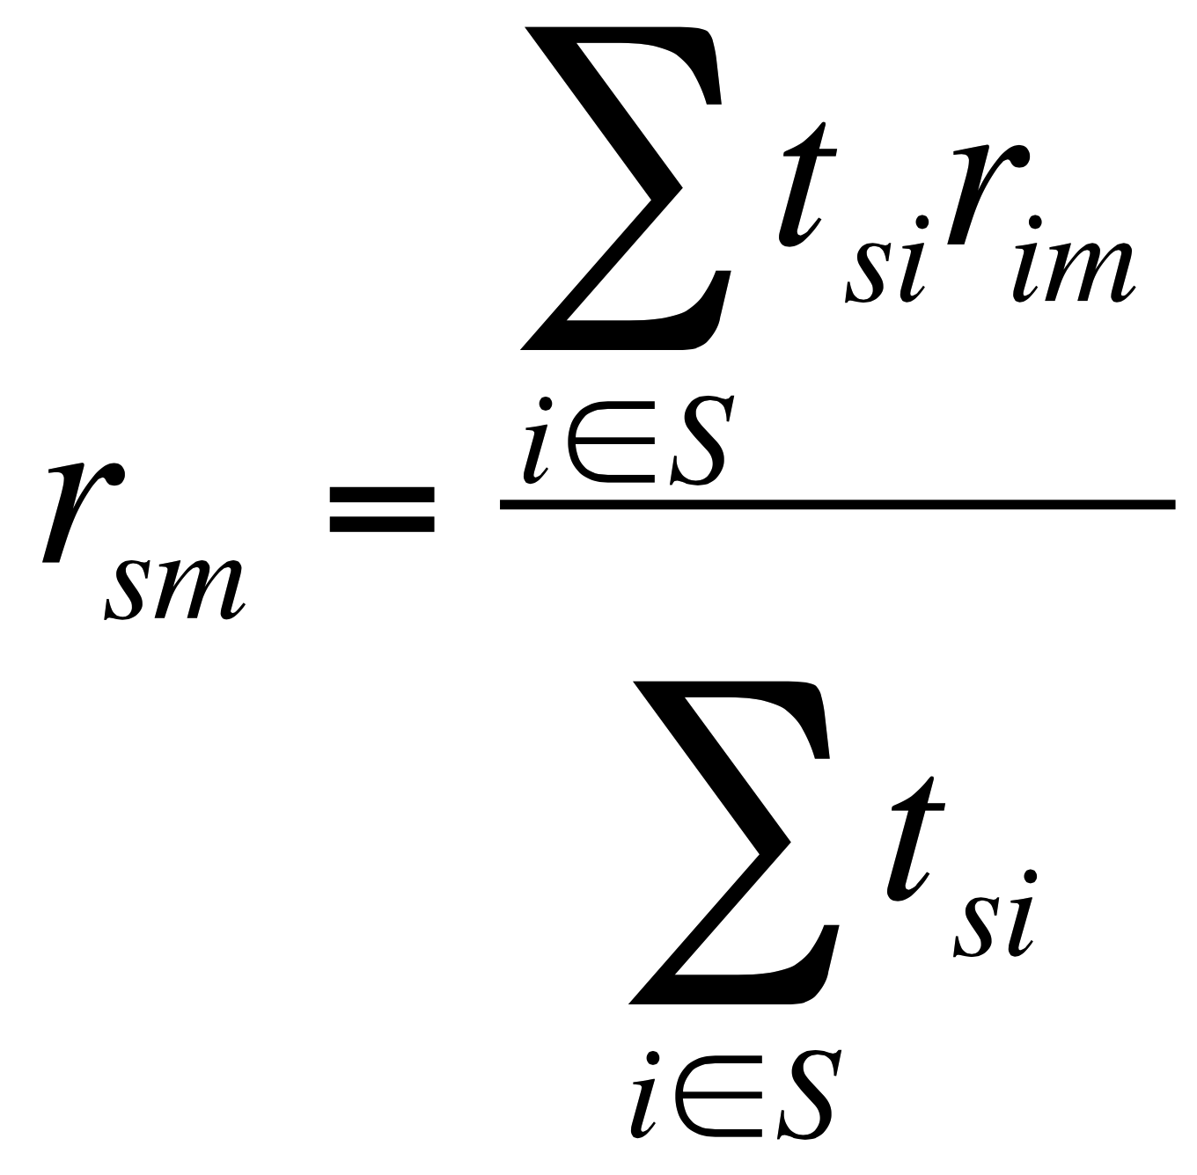
Memory based Social Recommender
TidalTrust
rating
(user i, item m)
rating
(user s, item m)
trust from social relation
(user s, user i)
Golbeck. Personalizing applications through integration of inferred trust values in semantic web-based social networks. Semantic Network Analysis Workshop, 2005.
Notes:
Average score of friends’ ratings on the same item.

Slide 13
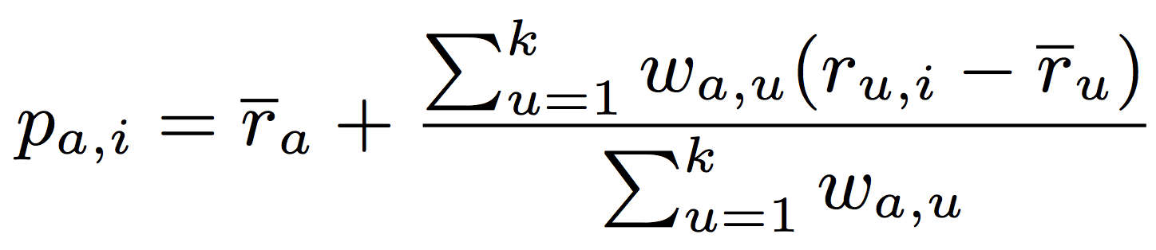
Memory based Social Recommender
MoleTrust
rating
(user u, item i)
average rating
(user u)
average rating
(user a)
predicted rating
(user a, item i)
trust from social relation
(user a, user u)
Massa et al. Trust-aware recommender systems. RecSys, 2007.
Notes:
Your preference bias on a given item. Your rating to the given item is over or below your average rating.

Slide 14
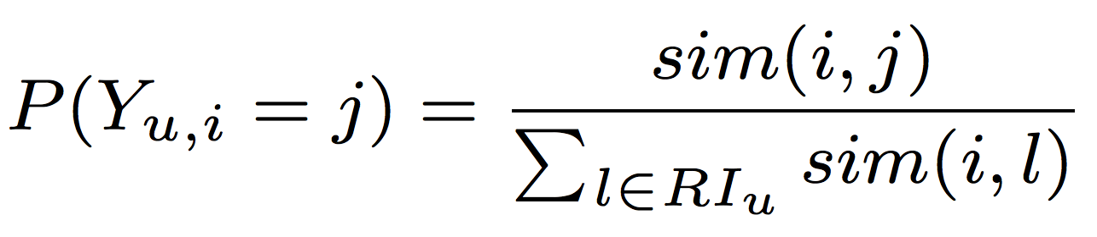
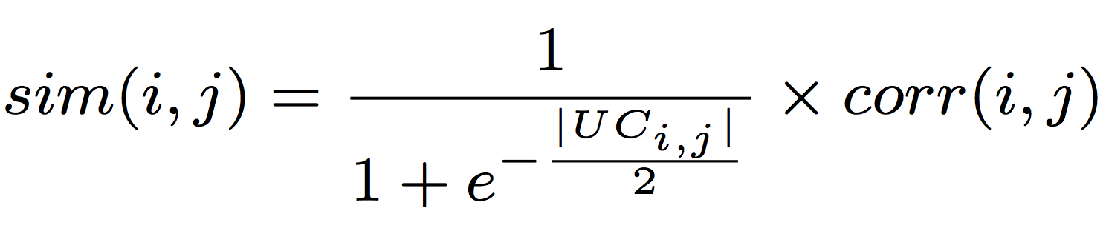
Memory based Social Recommender
similarity measure
(item i, item j)
TrustWalker
probability of
user u’s random walk
from item i to item j
Pearson correlation
of (item i, item j)
common user set
of (item i, item j)
Jamali et al. TrustWalker: A Random Walk Model for Combining Trust-based and Item-based Recommendation. KDD, 2009.
Notes:
Only the given item? What if we compute the similarity between items?

Slide 15
Model based Social Recommender
Optimization methods such as gradient based methods can be applied to find a well-worked optimal solution.
MF has a nice probabilistic interpretation with Gaussian noise.
MF is very flexible and allows us to include prior knowledge.
Social Recommendation CF
= Basic CF + Social Information Model
Tang et al. Social Recommendation: A Review. Social Network Analysis and Mining, 2013. Springer.
Notes:
Model based: Use matrix factorization for social recommender.

Slide 16
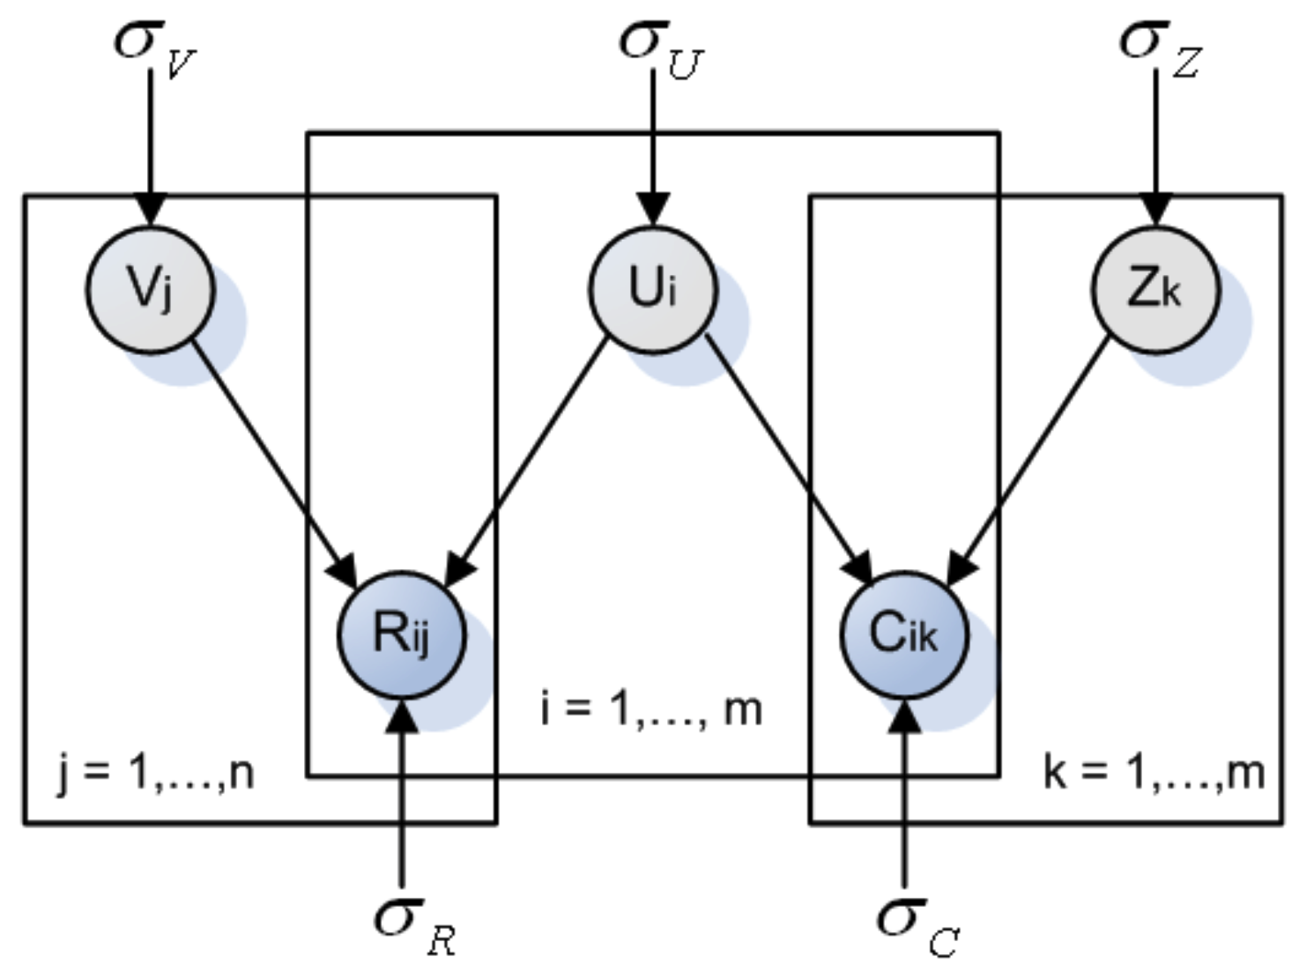
Model based Social Recommender
factor vector
SoRec
item vector
user vector
R: user-item
rating matrix
C: user-user
social matrix
Ma et al. Social Recommendation Using Probabilistic Matrix Factorization. CIKM, 2008.
Improving Recommender Systems by Incorporating Social Contextual Information. TIS, 2011.
Notes:
Optimize user vector with both rating matrix and social matrix with probabilistic graphical model.

Slide 17
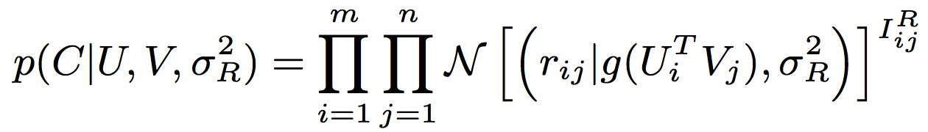
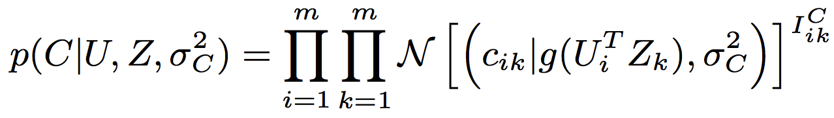
Model based Social Recommender
SoRec
R
Gaussian distribution
Logistic function
Observed
Notes:
Observation indicator, Gaussian distribution, logistic function.

Slide 18
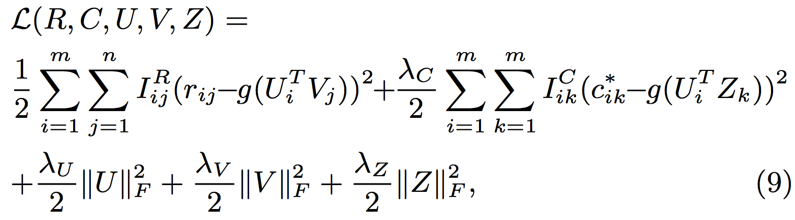
Model based Social Recommender
SoRec
behavioral term
social term
regularization terms
Notes:
Behavioral term, social term, regularization terms.

Slide 19
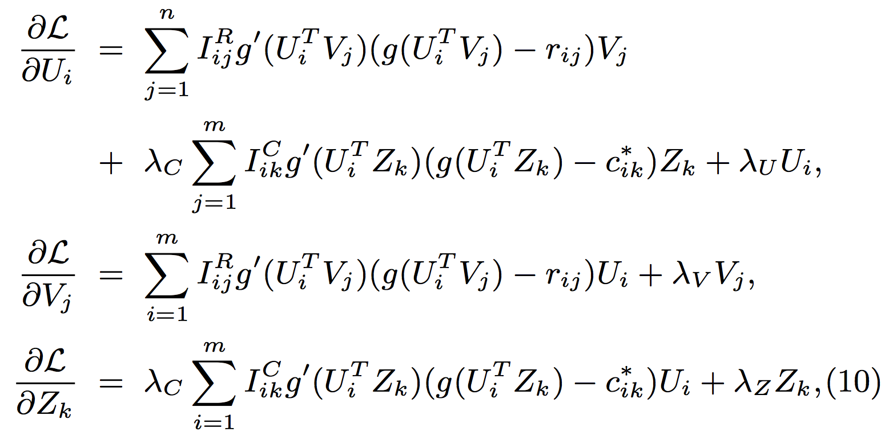
Model based Social Recommender
SoRec
Gradient Descent Methods
deviate of
Logistic
function

Slide 20
Model based Social Recommender
SoRec
Notes:
Review the whole framework of SoRec.

Slide 21
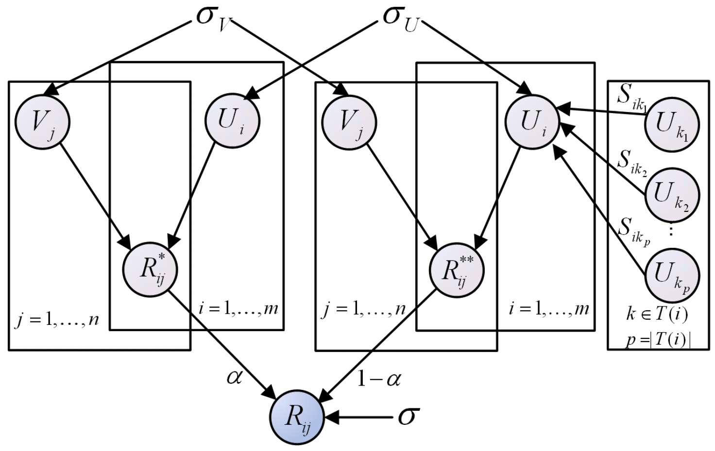
Model based Social Recommender
Replacing social with trust
“Social Trust” Ensemble for Epinion data
From user-item
matrix
From trusted friends
Operation “plus”
Ma et al. Learning to Recommend with Social Trust Ensemble. SIGIR, 2009.
Learning to Recommend with Explicit and Implicit Social Relations. TIST, 2011.
Notes:
Modeling social trust into the factorization framework: Rating and trust. Trade-off. Parameter alpha.

Slide 22
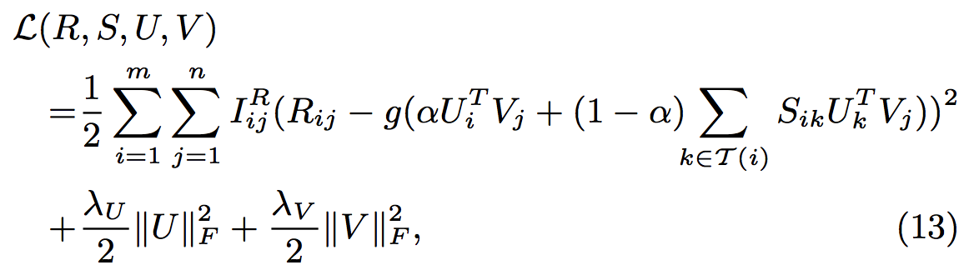
Model based Social Recommender
“Social Trust” Ensemble
From user-item
matrix
From trusted friends
Notes:
Trade-off.

Slide 23
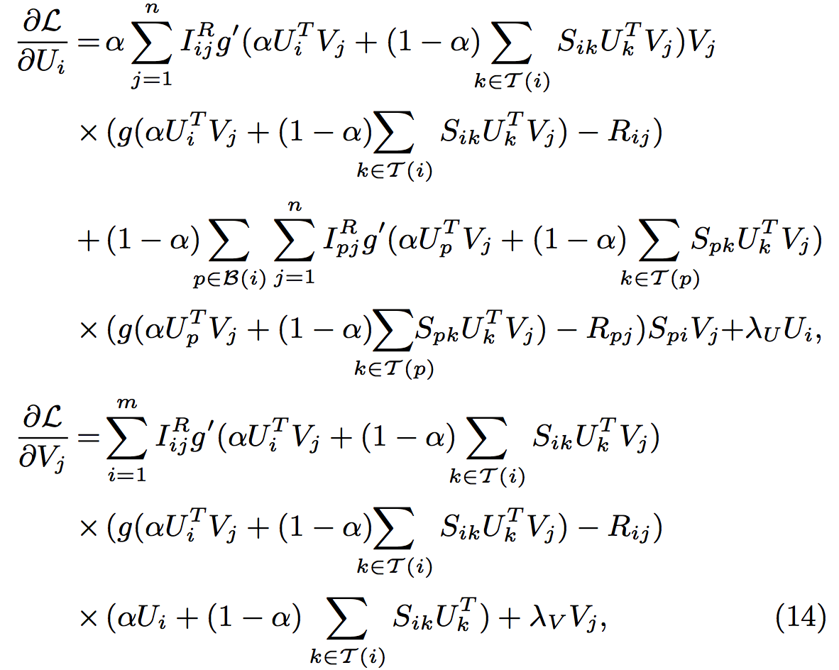
Model based Social Recommender
“Social Trust” Ensemble
Gradient
Descent
Methods

Slide 24
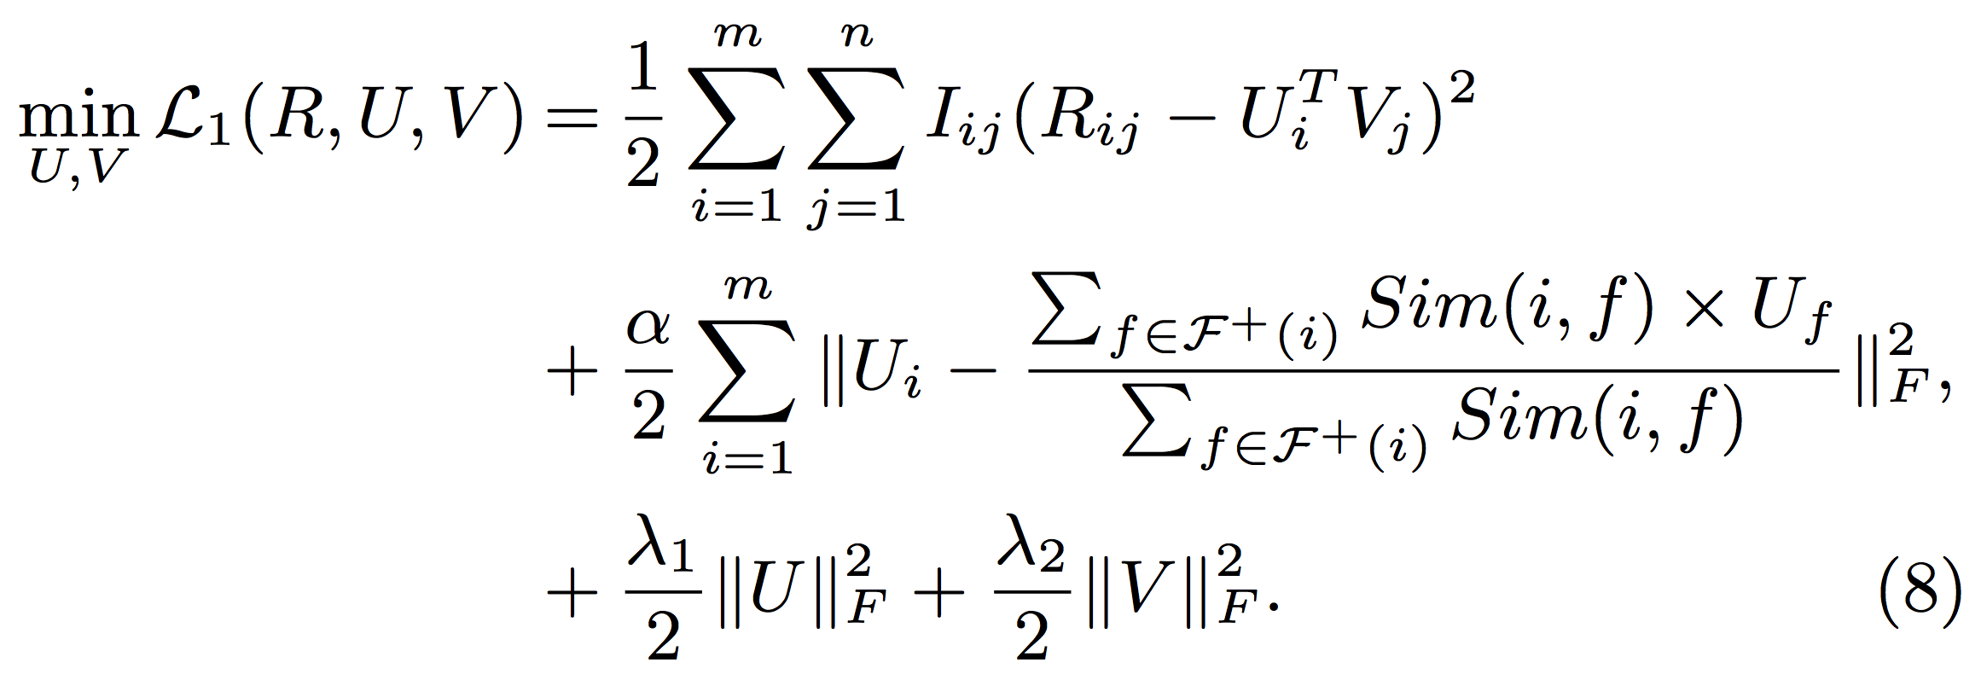
Model based Social Recommender
SoReg
Average-based regularization:
Regularize with the average of friends’ tastes
Information loss: Friends may have diverse tastes!!!
Ma et al. Recommender Systems with Social Regularization. WSDM, 2011.
Notes:
Your tastes are similar with the average tastes of your friends?

Slide 25
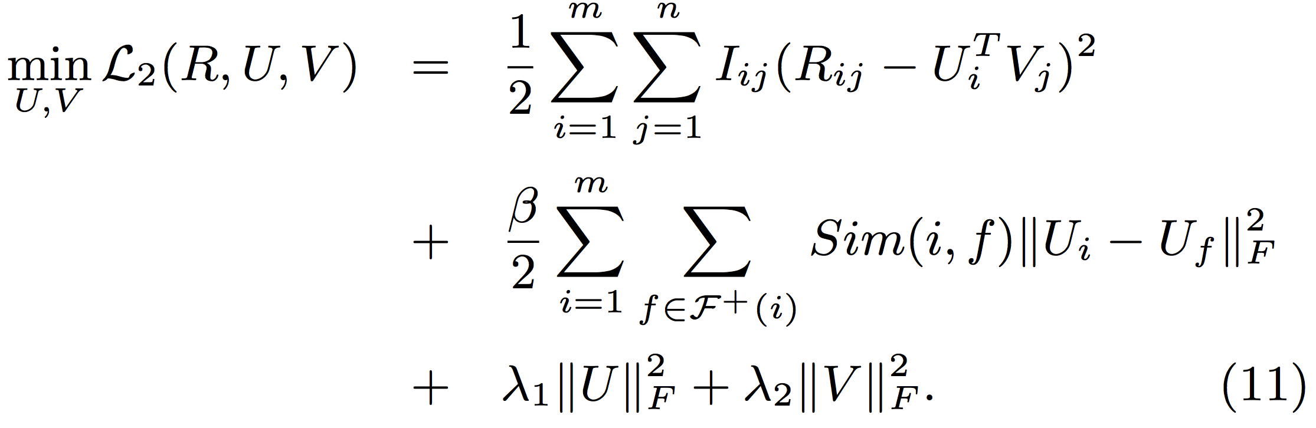
Model based Social Recommender
SoReg
Individual-based regularization:
Regularize with friends individually
Notes:
In fact, your tastes are similar with your friends who are strongly connected with you. This is better.

Slide 26
Related Work
Q: What are the factors of users’ decisions on retweeting? Can we observe them from the data? How to integrate the information for accurate prediction?
 | Behavior | Content | Social | Trust
Collaborative filtering (CF) [Herlocker et al. TOIS; Koren KDD] | ✔
Content-based filtering with CF [Balabanovic et al.; Liu et al. CIKM;] | ✔ | ✔
SoRec [Ma et al. CIKM, TIS] SoReg [Ma et al. WSDM] | ✔ |  | ✔
Trust-based methods [Massa et al. RecSys; Jamali et al. KDD; Ma et al. SIGIR, TIST] | ✔ |  |  | ✔

Slide 27
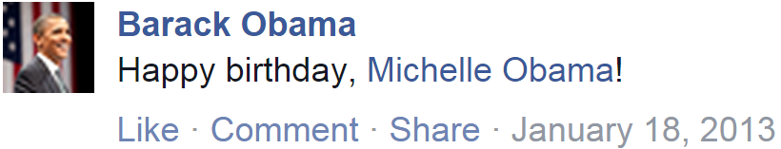
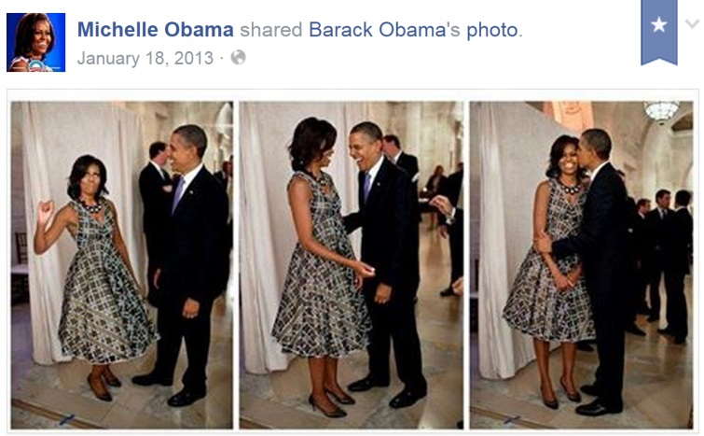
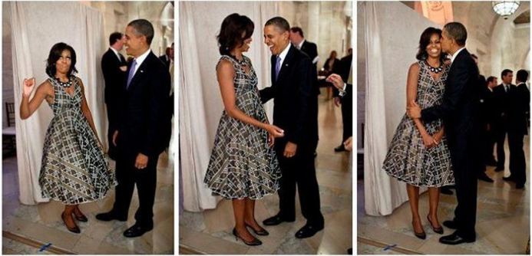
Observation: Social Contextual Factors
Will Michelle Obama share this message?
Please list your reasons.
Jiang et al. Social Contextual Recommendation. CIKM, 2012.
Social Recommendation with Contextual Information. TKDE, 2014.

Slide 28
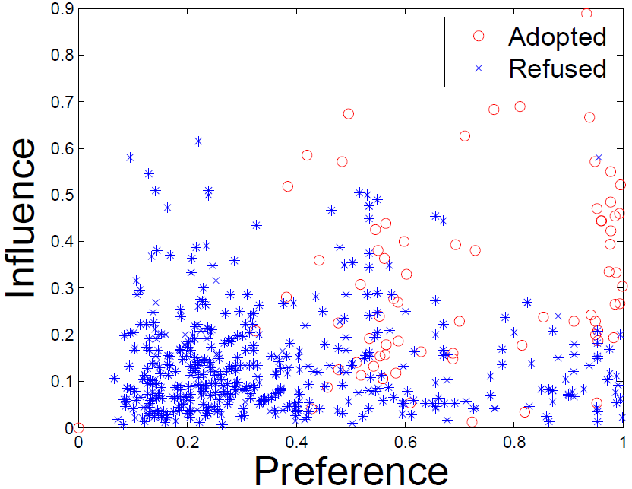
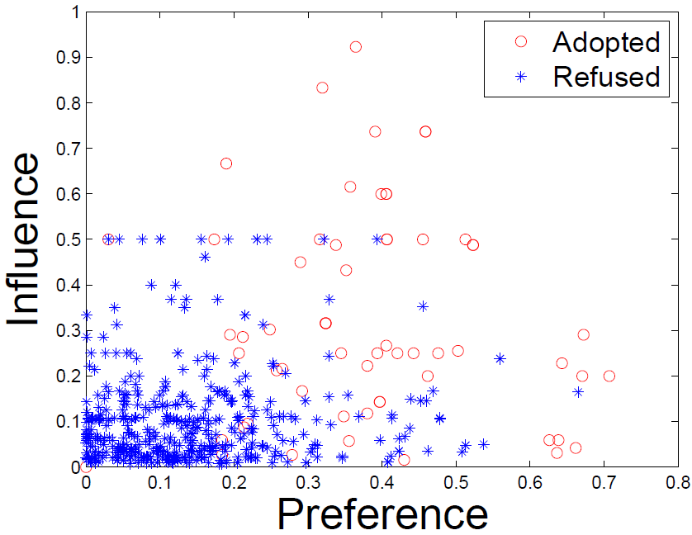
Observation: Social Contextual Factors
u
send
i
u
send
i
×
receive and retweet
receive but ignore
u
u
adopted
refused
↗
↗
China’s Facebook: Renren
China’s Twitter: Tencent Weibo

Slide 29
Representation: From Contextual Information to Contextual Factors
Content
Item-item similarity
Item latent features V
Personal preference
on the given item
Behavior
User-item interaction
User latent features U
Social
User-user social relation
Item sender G
Interpersonal influence
from the item’s sender
Interaction frequency
User-user interaction
User-user influence S

Slide 30
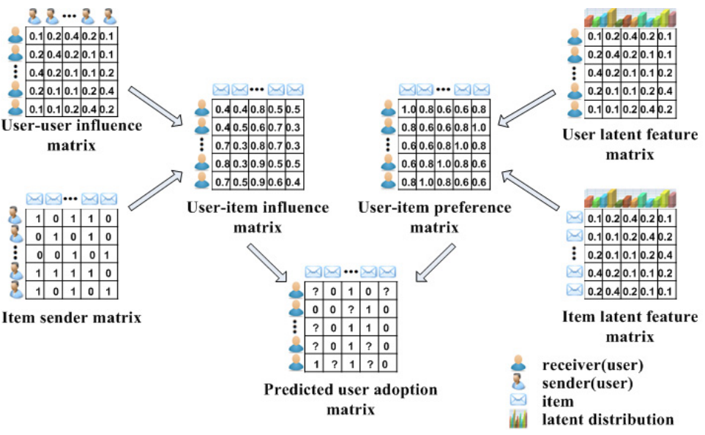
Model: ContextMF
S
U
G
V

Slide 31
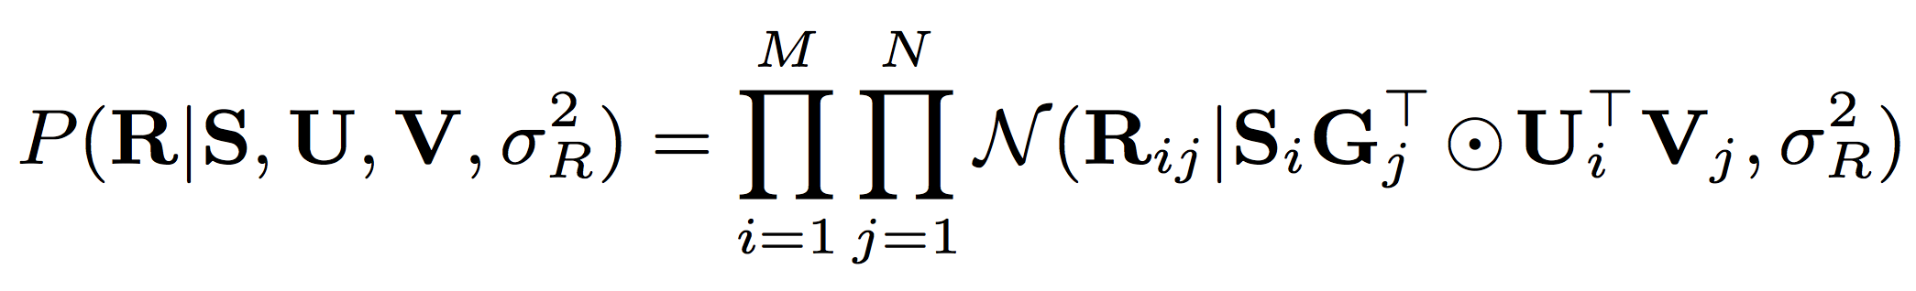
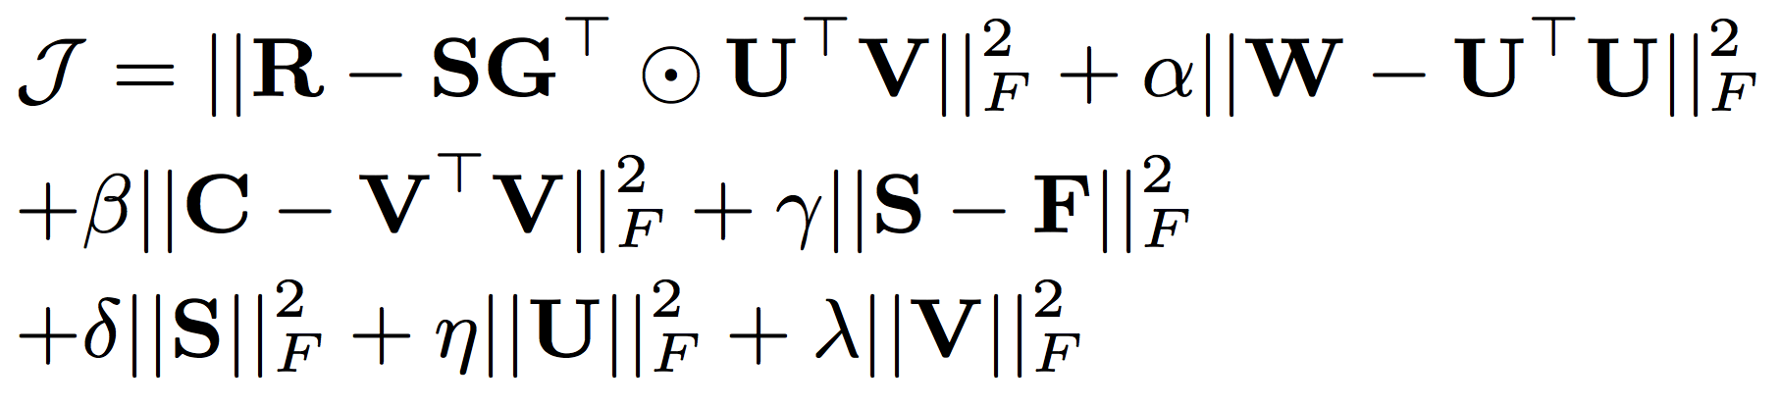
Model: ContextMF
behavior
influence
preference
behavior
interaction frequency/trust
item content
social relation

Slide 32
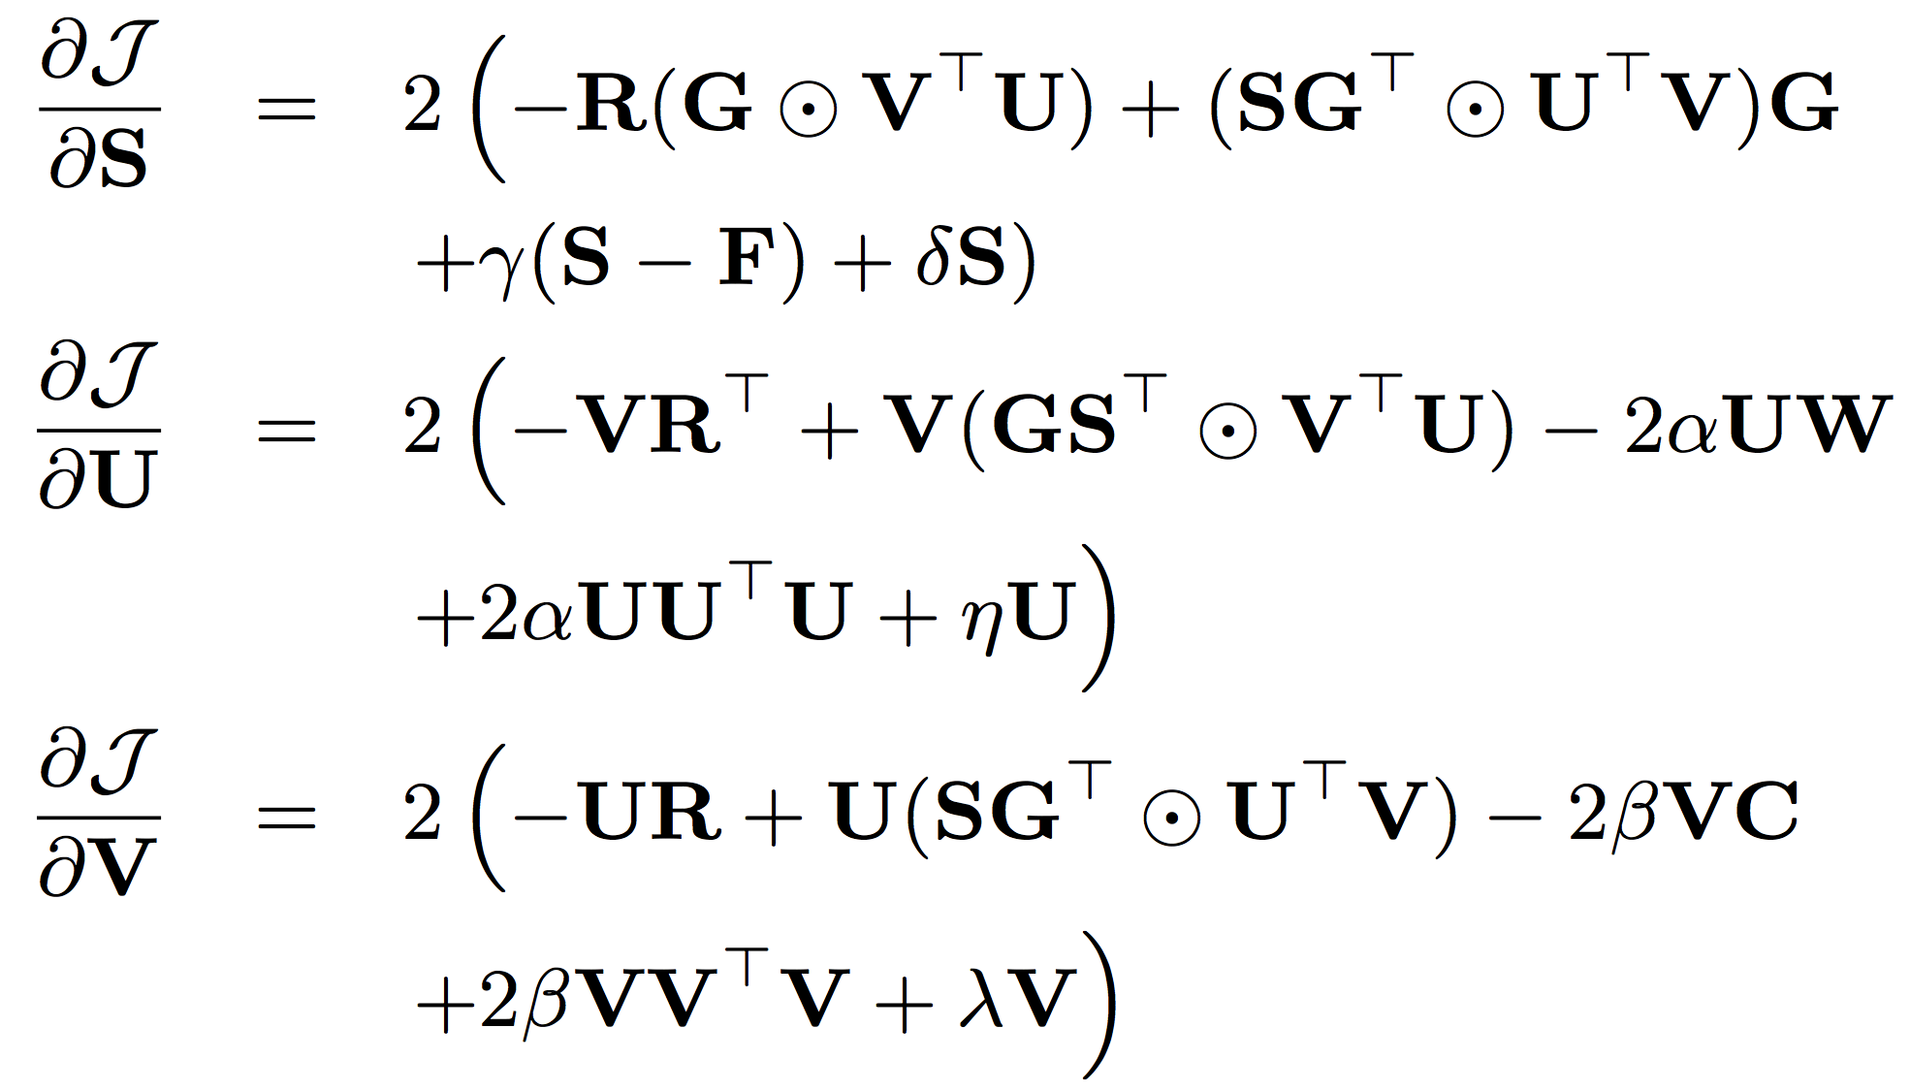
Model: ContextMF
Gradient descent method

Slide 33
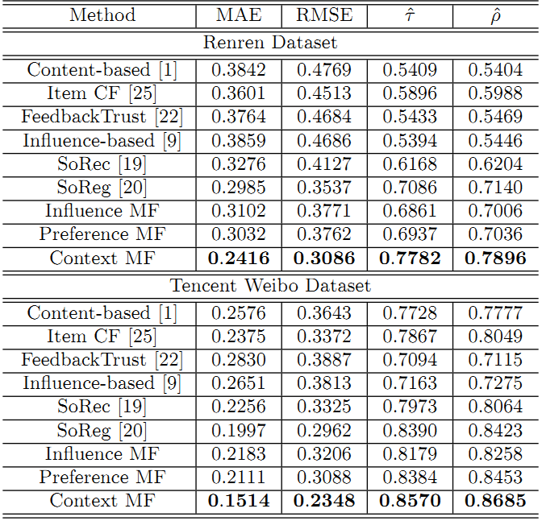
Experimental Results
vs. SoReg [TIST’11] | Renren | Tencent Weibo
MAE | ↓19.1% | ↓24.2%
RMSE | ↓12.8% | ↓20.7%
Kendall’s | ↑9.82% | ↑2.1%
Spearman’s | ↑10.6% | ↑3.1%
Deployed in Weibo News Feed. Improved conversion rate from 5.78% to 8.27% (relatively 43%).
#citations = 149

Slide 34



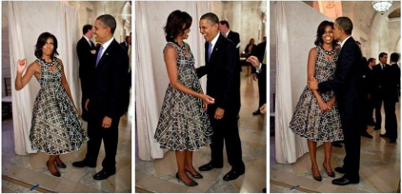
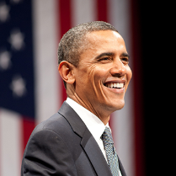
Observation: Spatial Context
Place
Device
Photo
With whom?
Who post?
Text
post
Jan. 18
Birthday party
@ White house
Jiang et al. Flexible Evolutionary Multi-faceted Analysis for Dynamic Behavioral Pattern Discovery. KDD, 2014.

Slide 35
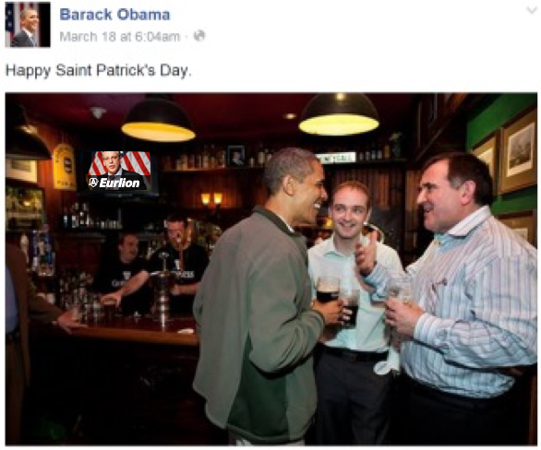
Observation: Temporal Context
Photo
Text
post
post
time
Jan. 18
Birthday party
@ White house
March 17
St. Patrick’s Day
@ Bar

Slide 36
Representation: Tensor Sequence
Tasks
time
Who post
Text
Behavior
Place
Behavior modeling
Spatial info:
Multi-faceted
Tensor sequence
Temporal info:
Dynamic
Pattern discovery
Decomposition & Completion
Behavior prediction
≈
x
x

Slide 37
Challenges: Sparsity and Complexity
Addressing sparsity: Flexible regularization with auxiliary data
Addressing high complexity: Incremental updates for projection matrix
Regularization:
Social context
user
item
…
user
item
time
t₃
t₂
time
item
item
t₁
user
user
t₁
t₂
t₃

Slide 38
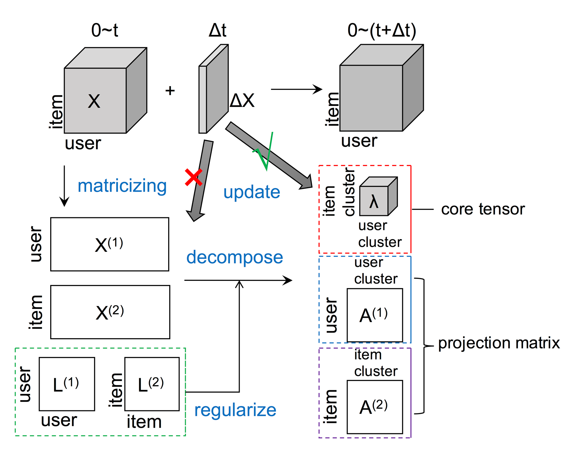
Model: FEMA Flexible Evolutionary Multi-faceted Analysis

Slide 39
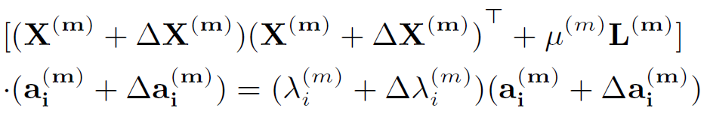
Tensor Perturbation Theory

Slide 40
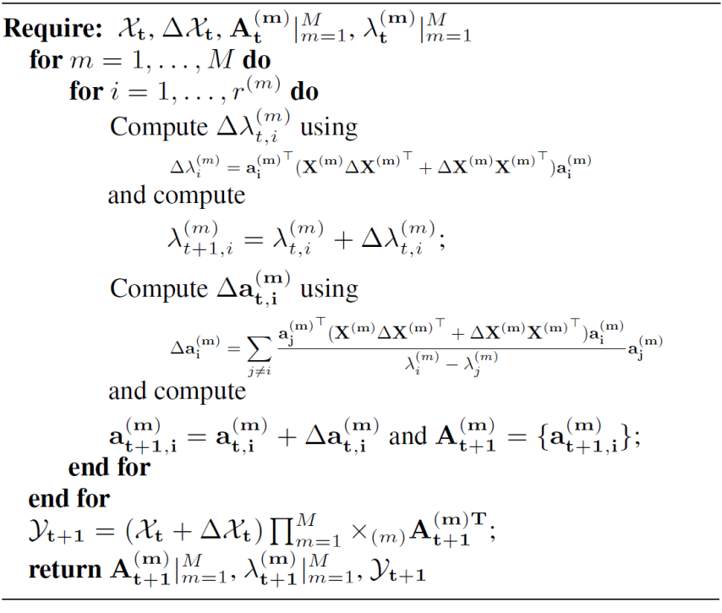
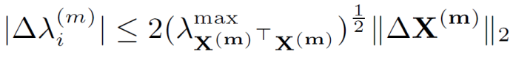
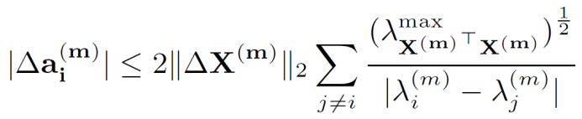
Algorithm: FEMA
Approximation
Bound Guarantee
core tensor
projection matrix

Slide 41
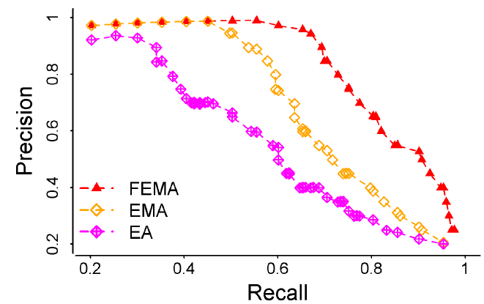
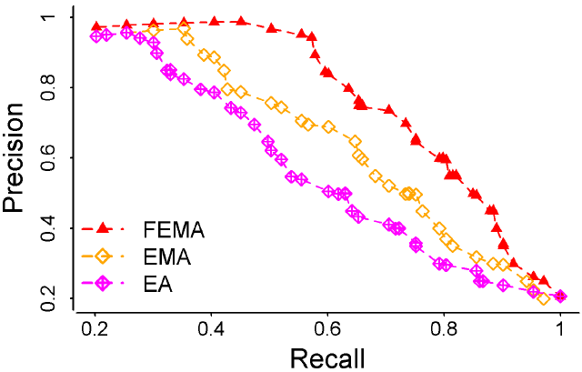
Results: FEMA > EMA > EA
 | Microsoft Academic Search |  | Tencent Weibo mentions “@”
 | MAE | RMSE | MAE | RMSE
FEMA | 0.735 | 0.944 | 0.894 | 1.312
EMA | 0.794 | 1.130 | 0.932 | 1.556
EA | 0.979 | 1.364 | 1.120 | 1.873
Precision vs Recall
X
L
X
X

Slide 42
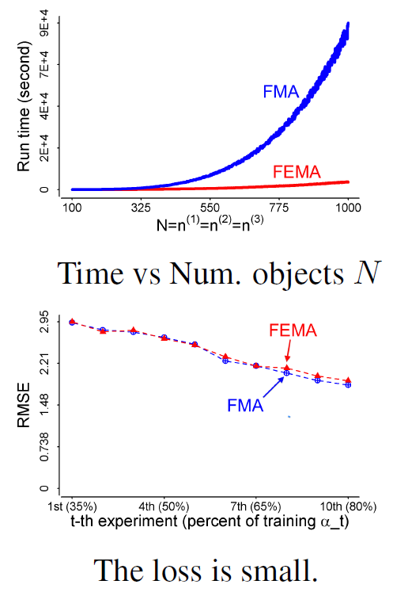
Results: Efficiency
Re-decomposition:
Re-compute projection matrices
Evolutionary analysis:
Use ΔX to update λ and a
Evolutionary analysis:
Use ΔX to update λ and a
Re-decomposition:
Re-compute projection matrices

Slide 43
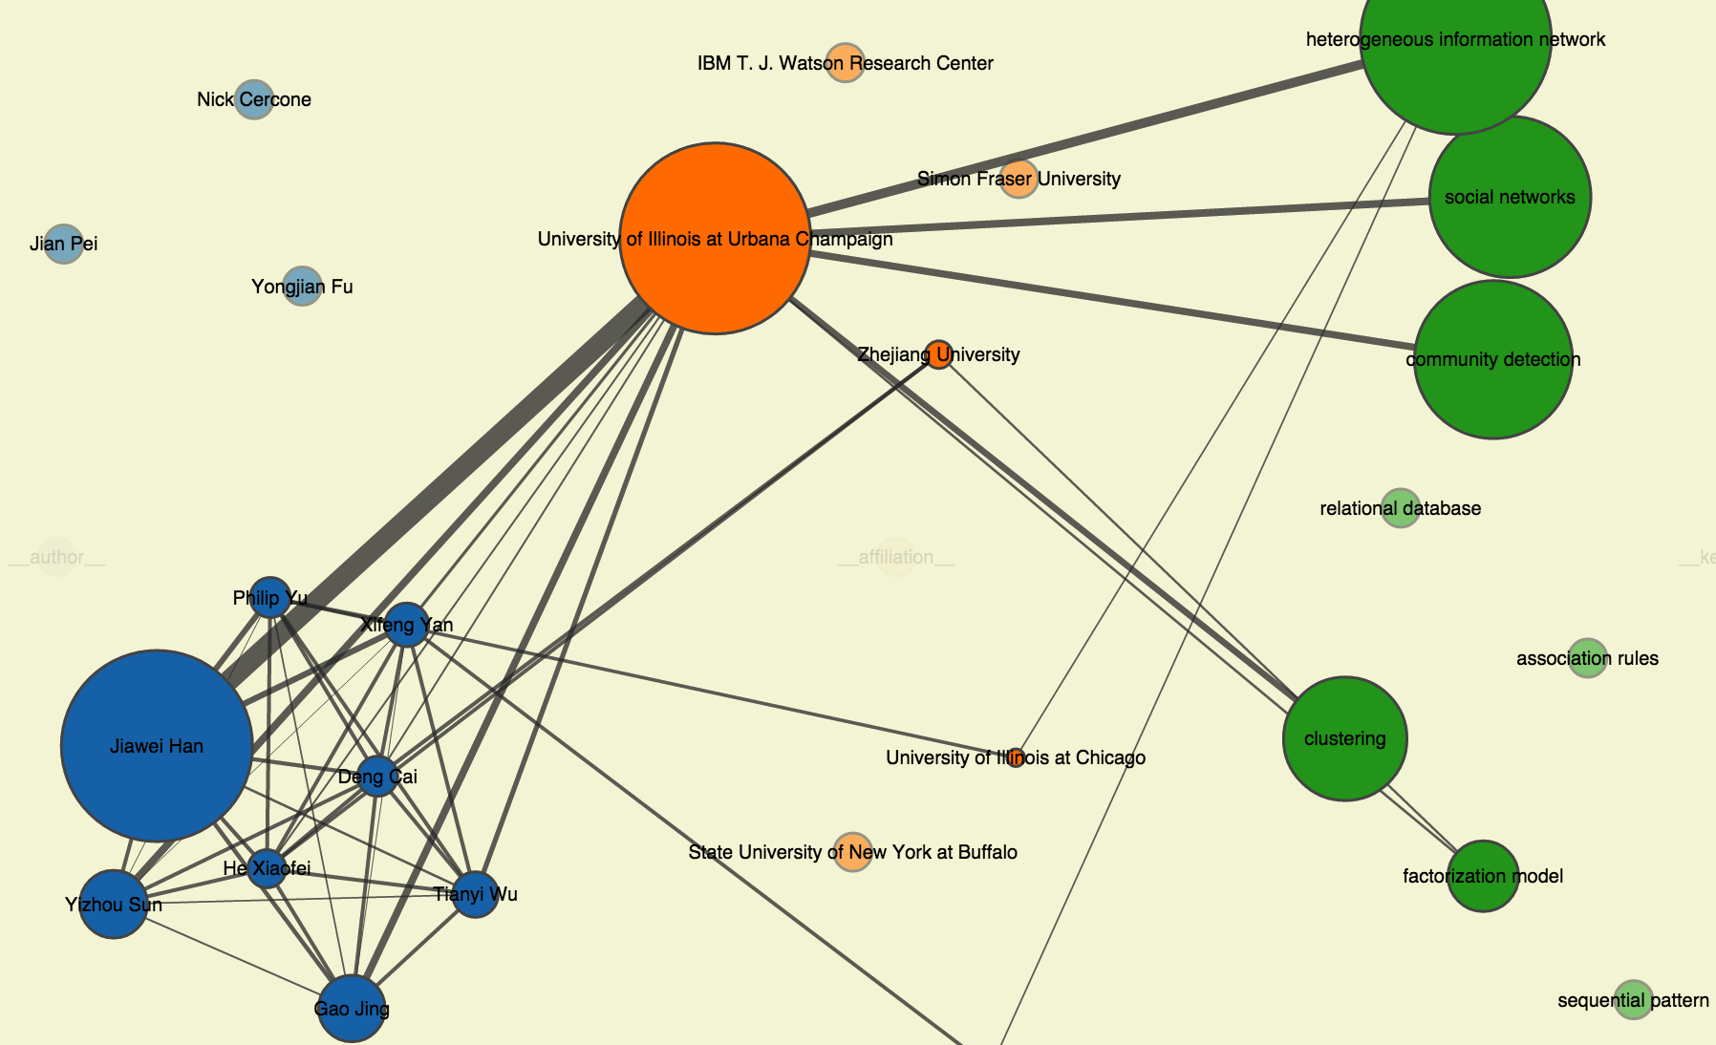
Demo: Author@Affiliation#Keyword
http://www.meng-jiang.com/demos/fema/mas/

Slide 44
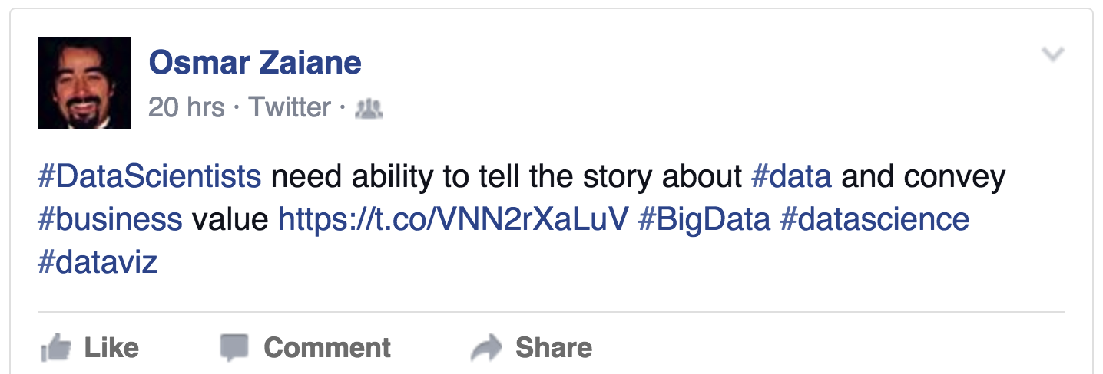
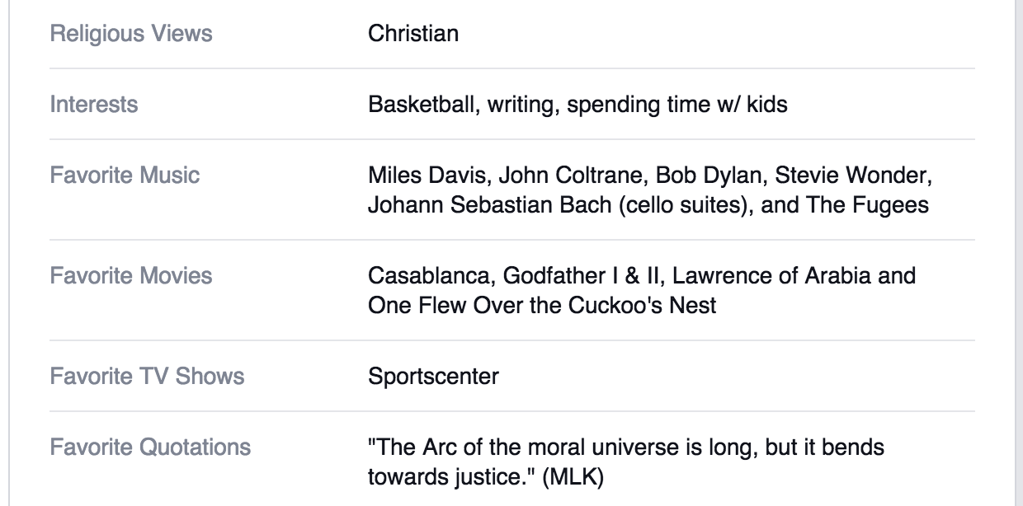
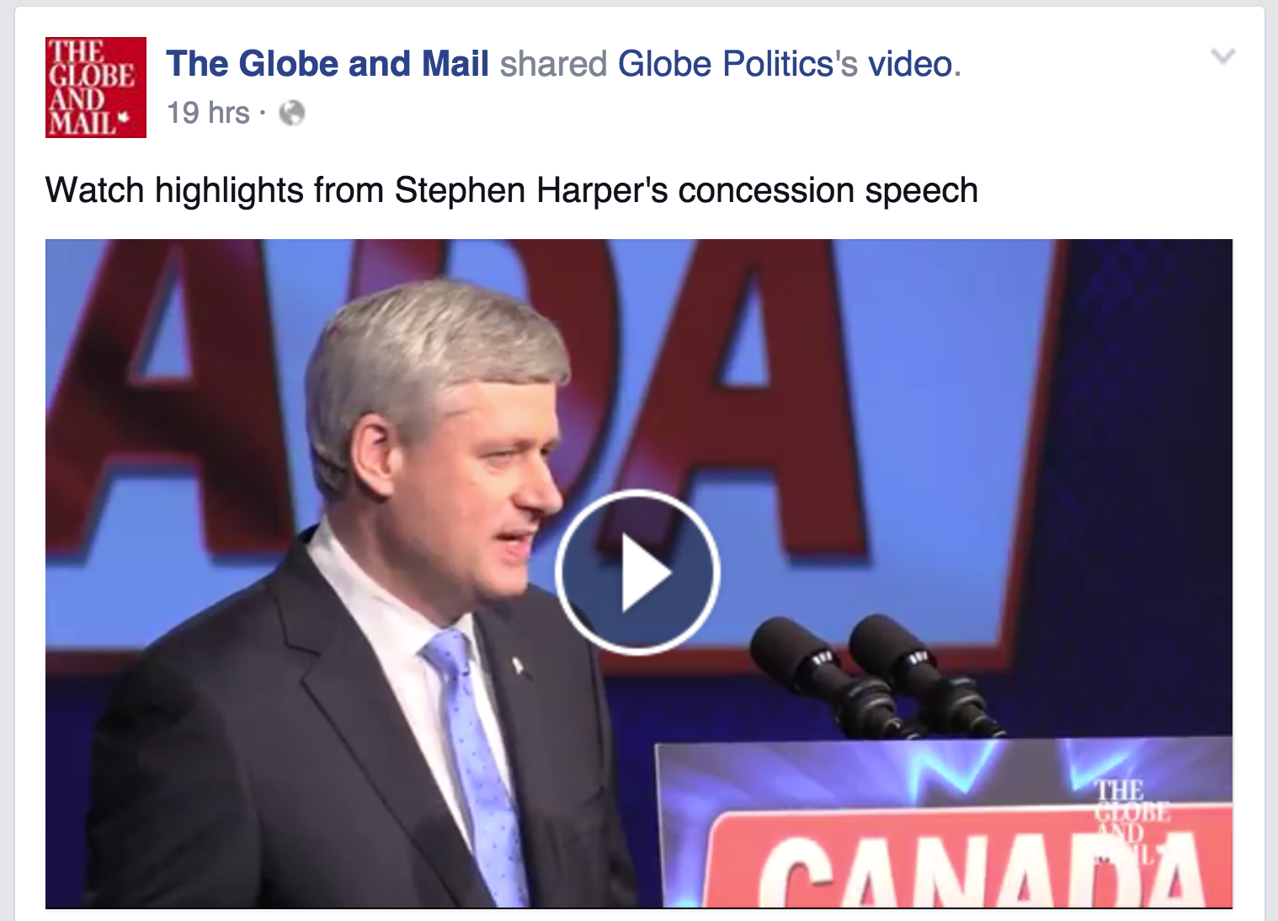
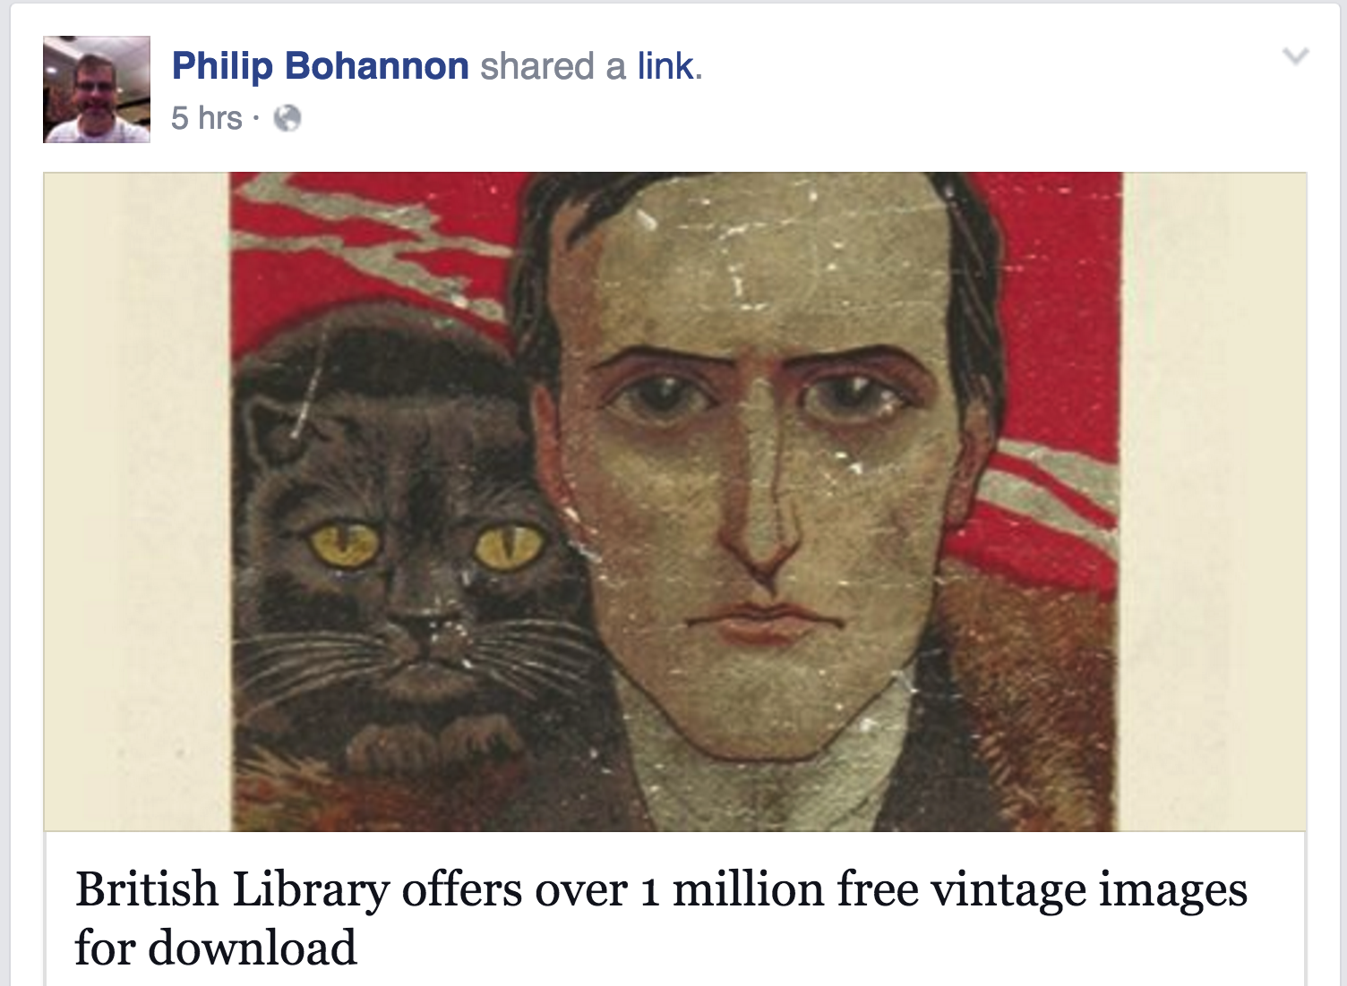
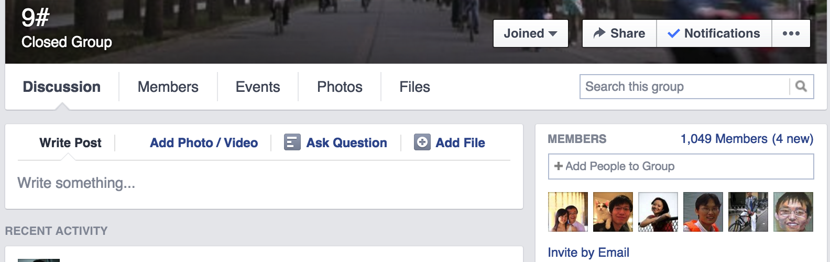
Observation: Multiple Domains
Jiang et al. Social Recommendation across Multiple Relational Domains. CIKM, 2012.
Social Recommendation with Cross-Domain Transferable Knowledge. TKDE, 2015.

Slide 45
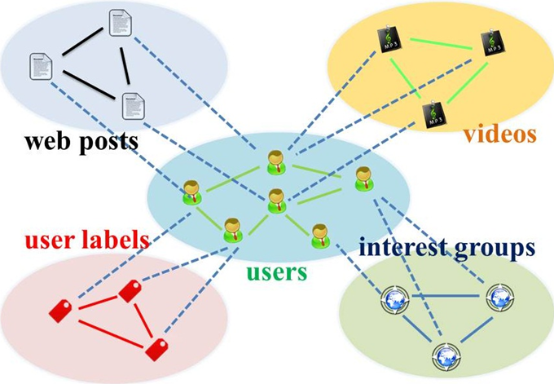
Representation: Star-Structured Graph

Slide 46
Representation: Social Bridge
Rtgt
Raux1
Raux3
Raux2
Bridge: Tie strength

Slide 47






Algorithm: Hybrid Random Walk
Updating cross-domain links
Updating within-domain links

Slide 48



Results
Comparing with Random Walk with Restarts Models
Comparing with Social Recommendation Baselines

Slide 49

Results: Insight
Knowledge transfer from auxiliary domains improves cold-start users’ behavior prediction
Using aux. (label) data, saving 60-70% tgt. (post) data
35% user-post
0 user-label
0 user-post
100% user-label
60% user-post
0 user-label
18% user-post
100% user-label

Slide 50
Observation: Multiple Platforms
Jiang et al. Little is Much: Bridging Cross-Platform Behaviors through Overlapped Crowds. AAAI, 2016.

Slide 51

Observation: Cross-Platform

Slide 52



Observation: Partially Overlapped Crowds

Slide 53

Representation: When NO Transfer
Sina Weibo
tags/entities
Douban
movies/books
User set | Weibo tweet entity to Douban movie
 | RMSE | MAP
A | Auxiliary platform data!
C | 0.779 | 0.805
B | 1.439 | 0.640
Sina Weibo
users
A
C
Douban
users
B
User set | Douban book to Weibo social tag
 | RMSE | MAP
A | 0.429 | 0.464
C | 0.267 | 0.666
B | Auxiliary platform data!

Slide 54

Algorithm: XPTrans

Slide 55

Algorithm: XPTrans
Input
Tgt./Aux. platform P/Q;
Behavior data R(P)/R(Q);
Observation W(P)/W(Q);
Overlapping indicator W(P,Q),
Output
User latent representation U(P)/U(Q);
Item latent representation V(P)/V(Q);
Missing values in R(P)
Objective function
Target platform
Auxiliary platform
Overlapping user similarity
(Pair-wise regularization)

Slide 56
Results: Leveraging Auxiliary Platform Data
Transfer via the Same
Latent Space
NO Transfer
User set | Weibo tweet entity to Douban movie
 | RMSE | MAP
A | Auxiliary platform data!
C | 0.779 | 0.805
B | 1.439 | 0.640
User set | Weibo tweet entity to Douban movie
 | RMSE | MAP
A
C | 0.757 | 0.811
B | 1.164 (-19%) | 0.702 (+9.7%)
User set | Douban book to Weibo social tag
 | RMSE | MAP
A | 0.429 | 0.464
C | 0.267 | 0.666
B | Auxiliary platform data!
User set | Douban book to Weibo social tag
 | RMSE | MAP
A | 0.411 (-4.2%) | 0.487 (+5.0%)
C | 0.256 | 0.681
B

Slide 57
Results: Leveraging Different Latent Spaces
Transfer via the Same
Latent Space
Transfer via Different
Latent Spaces
User set | Weibo tweet entity to Douban movie
 | RMSE | MAP
A
C | 0.757 | 0.811
B | 1.164 | 0.702
User set | Weibo tweet entity to Douban movie
 | RMSE | MAP
A
C | 0.715 | 0.821
B | 0.722 (-38%) | 0.820 (+17%)
User set | Douban book to Weibo social tag
 | RMSE | MAP
A | 0.411 | 0.487
C | 0.256 | 0.681
B
User set | Douban book to Weibo social tag
 | RMSE | MAP
A | 0.374 (-11%) | 0.533 (+12%)
C | 0.236 | 0.705
B

Slide 58
Results: Where Amazing Happens
Transfer via Different
Latent Spaces
NO Transfer
User set | Weibo tweet entity to Douban movie
 | RMSE | MAP
A | Auxiliary platform data!
C | 0.779 | 0.805
B | 1.439 | 0.640
User set | Weibo tweet entity to Douban movie
 | RMSE | MAP
A
C | 0.715 | 0.821
B | 0.722 | 0.820
User set | Douban book to Weibo social tag
 | RMSE | MAP
A | 0.429 | 0.464
C | 0.267 | 0.666
B | Auxiliary platform data!
User set | Douban book to Weibo social tag
 | RMSE | MAP
A | 0.374 | 0.533
C | 0.236 | 0.705
B

Slide 59

Results: Different Sizes of Latent Spaces

Slide 60
Summary
Like, Reply, Share, Retweet, Favorite, Comment …
Memory based social recommenders
TidalTrust, MoleTrust, TrustWalker
Model based social recommenders
SoRec, “Social Trust” Ensemble, SoReg
Observations, Representations, Models
ContextMF: Social contexts (preference & influence)
FEMA: Spatiotemporal contexts (multidimensional)
HybridRW: Cross-domain behavior modeling
XPTrans: Cross-platform behavior modeling

Slide 61

Acknowledgement

Slide 62
References
D. Blei, A. Ng, and M. Jordan. “Latent dirichlet allocation.” JMLR, 2003.
J. Herlocker, J. Konstan, L. Terveen, J. Riedl. “Evaluating collaborative filtering recommender systems.” ACM TOIS, 2004.
Y. Koren, R. Bell, C. Volinsky. “Matrix factorization techniques for recommender systems.” Computer, 2009.
Y. Koren. “Factorization meets the neighborhood: A multifaceted collaborative filtering model.” KDD, 2008.
Y. Koren. “Collaborative filtering with temporal dynamics.” CACM, 2010.
M. Balabanovic and Y. Shoham. “FAB: Content-based, collaborative recommendation.” CACM, 1997.
N. Liu and Q. Yang. “Eigenrank: A ranking-oriented approach to collaborative filtering.” SIGIR, 2008.
N. Liu, M. Zhao, and Q. Yang. “Probabilistic latent preference analysis for collaborative filtering.” CIKM, 2009.

Slide 63
References
H. Ma, H. Yang, M. Lyu, and I. King. “Sorec: Social recommendation using probabilistic matrix factorization.” CIKM, 2008.
H. Ma, T. Zhou, M. Lyu, and I. King. “Improving recommender systems by incorporating social contextual information.” ACM TOIS, 2011.
H. Ma, D. Zhou, C. Liu, M. Lyu, and I. King. “Recommender systems with social regularization.” WSDM, 2011.
J. Leskovec, A. Singh, and J. Kleinberg. “Patterns of influence in a recommendation network.” PAKDD, 2006.
P. Massa and A. Paolo. “Trust-aware recommender systems.” RecSys, 2007.
M. Jamali and E. Martin. “TrustWalker: A random walk model for combining trust-based and item-based recommendation.” KDD, 2009.
H. Ma, I. King, and M. Lyu. “Learning to recommend with social trust ensemble.” SIGIR, 2009.
H. Ma. I. King, and M. Lyu. “Learning to recommend with explicit and implicit social relations.” ACM TIST, 2011.

Slide 64
References
M. Faloutsos, P. Faloutsos, and C. Faloutsos. “On power-law relationships of the internet topology.” SIGCOMM, 1999.
A. Broder, R. Kumar, F. Maghoul, P. Raghavan, S. Rajagopalan, R. Stata, A. Tomkins, and J. Weiner. “Graph structure in the web.” Computer Networks, 2000.
F. Chung and L. Lu. “The average distances in random graphs with given expected degrees.” PNAS, 2002.
J. Kleinberg. “Authoritative sources in a hyperlinked environment.” JACM, 1999.
H. Kwak, C. Lee, H. Park, and S. Moon. “What is Twitter, a social network or a news media?” WWW, 2010.
B. Hooi, H.A. Song, A. Beutel, N. Shah, K. Shin, and C. Faloutsos. “Fraudar: Bounding graph fraud in the face of camouflage.” KDD, 2016.
C. Aggarwal and J. Han. “Frequent pattern mining.” Springer, 2014.
J. Han, J. Pei, B. Mortazavi-Asl, Q. Chen, U. Dayal, and M. Hsu. “FreeSpan: Frequent pattern-projected sequential pattern mining.” KDD, 2000.

Slide 65
References
X. Yan and J. Han. “gspan: Graph-based substructure pattern mining.” ICDM, 2003.
X. Yan and J. Han. “CloseGraph: Mining closed frequent graph patterns.” KDD, 2003.
Y. Sun, J. Han, X. Yan, P.S. Yu, and T. Wu. “PathSim: Meta path-based top-k similarity search in heterogeneous information networks.” VLDB, 2011.
Y. Sun, Y. Yu, and J. Han. “Ranking-based clustering of heterogeneous information networks with star network schema.” KDD, 2009.
Y. Sun, J. Han, P. Zhao, Z. Yin, H. Cheng, and T. Wu. “RankClus: Integrating clustering with ranking for heterogeneous information network analysis.” EDBT, 2009.
Y. Sun, R. Barber, M. Gupta, C. Aggarwar, and J. Han. “Co-author relationship prediction in heterogeneous bibliographic networks.” ASONAM, 2011.
A. El-Kishky, Y. Song, C. Wang, C.R. Voss, and J. Han. “Scalable topical phrase mining from text corpora.” VLDB, 2014.
J. Liu, J. Shang, C. Wang, X. Ren, and J. Han. “Mining quality phrases from massive text corpora.” SIGMOD, 2015.

Slide 66
References
X. Ren, A. El-Kishky, C. Wang, F. Tao, C.R. Voss, and J. Han. “Effective entity recognition and typing by relation phrase-based clustering.” KDD, 2015.
X. Ren, W. He, M. Qu, C.R. Voss, H. Ji, and J. Han. “Label noise reduction in entity typing by heterogeneous partial-label embedding.” KDD, 2016.
C. Wang, M. Danilevsky, N. Desai, Y. Zhang, P. Nguyen, T. Taula, and J. Han. “A phrase mining framework for recursive construction of a topical hierarchy.” KDD, 2013.
E.E. Papalexakis, C. Faloutsos, N.D. Sidiropoulos. “ParCube: Sparse parallelizable tensor decompositions.” PKDD, 2012.
D. Koutra, U. Kang, J. Vreeken, and C. Faloutsos. “VOG: Summarizing and understanding large graphs.” SDM, 2014.
R. Gupta, A. Halevy, X. Wang, S.E. Whang, and F. Wu. “Biperpedia: An ontology for search applications.” VLDB, 2014.
M. Yahya, S. Whang, R. Gupta, and A. Halevy. “ReNoun: Fact extraction for nominal attributes.” EMNLP, 2014.
A. Halevy, N. Noy, S. Sarawagi, S.E. Whang, and X. Yu. “Discovering structure in the universe of attribute names.” WWW, 2016.

Slide 67
References
Q. Li, Y. Li, J. Gao, B. Zhao, W. Fan, and J. Han. “Resolving conflicts in heterogeneous data by truth discovery and source reliability estimation.” SIGMOD, 2014.
Q. Li, Y. Li, J. Gao, L. Su, B. Zhao, M. Demirbas, W. Fan, and J. Han. “A confidence-aware approach for truth discovery on long-tail data.” VLDB, 2014.
F. Ma, Y. Li, Q. Li, M. Qiu, J. Gao, S. Zhi, L. Su, B. Zhao, H. Ji, and J. Han. “Faitcrowd: Fine grained truth discovery for crowdsourced data aggregation.” KDD, 2015.
Y. Li, J. Gao, C. Meng, Q. Li, L. Su, B. Zhao, W. Fan, and J. Han. “A survey on truth discovery.” KDD Explorations Newsletter, 2016.
S. Zhi, B. Zhao, W. Tong, J. Gao, D. Yu, H. Ji, and J. Han. “Modeling truth existence in truth discovery.” KDD, 2015.
S. Kumar, R. West, and J. Leskovec. “Disinformation on the Web: Impact, characteristics, and detection of Wikipedia hoaxes.” WWW, 2016.
S. Kumar, F. Spezzano, and V.S. Subrahmanian. “Identifying malicious actors on social media.” ASONAM, 2016. (tutorial)

Slide 68
Thank you!
Data-Driven Behavioral Analytics:
Observations, Representations and Models

